Slide 1
Project `Alpha`
File One / File Two / File Three
User A Commit
Chg. File One
Del. File Two
Add. File Four
User B Commit
Chg. File One
Chg. File Two
Del. File Three
Add. File Five

Slide 2
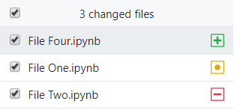
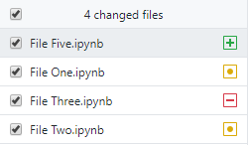

Slide 3
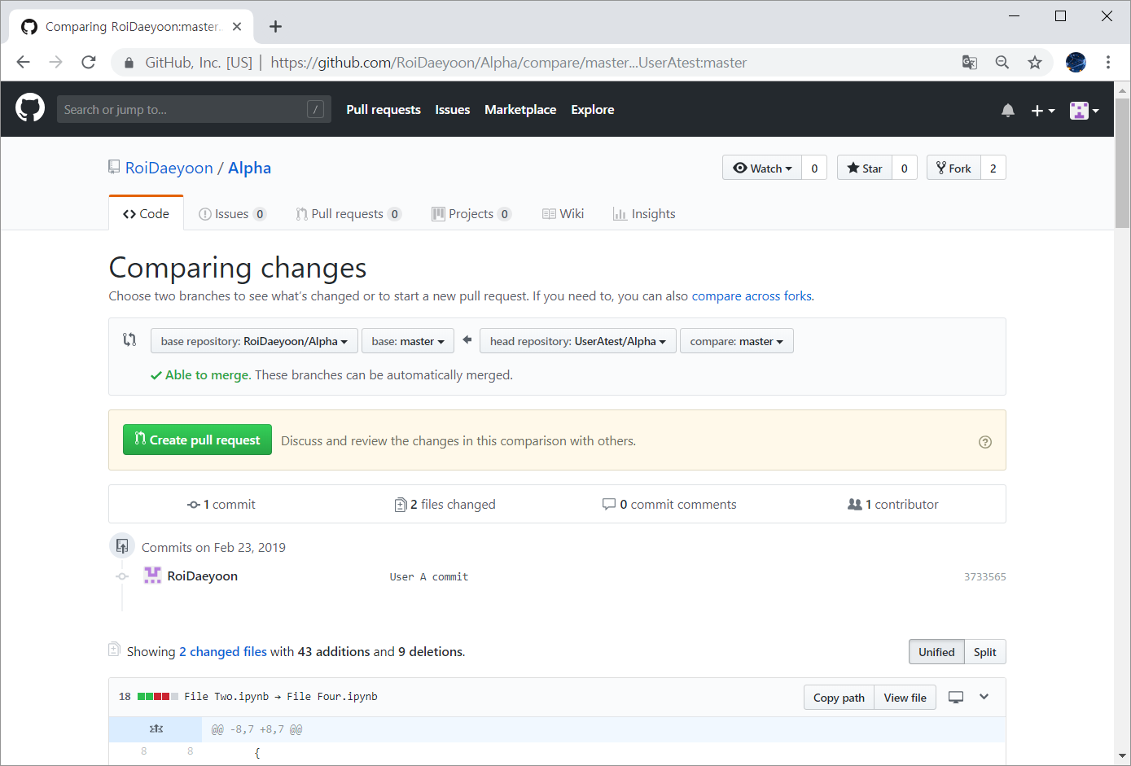

Slide 4
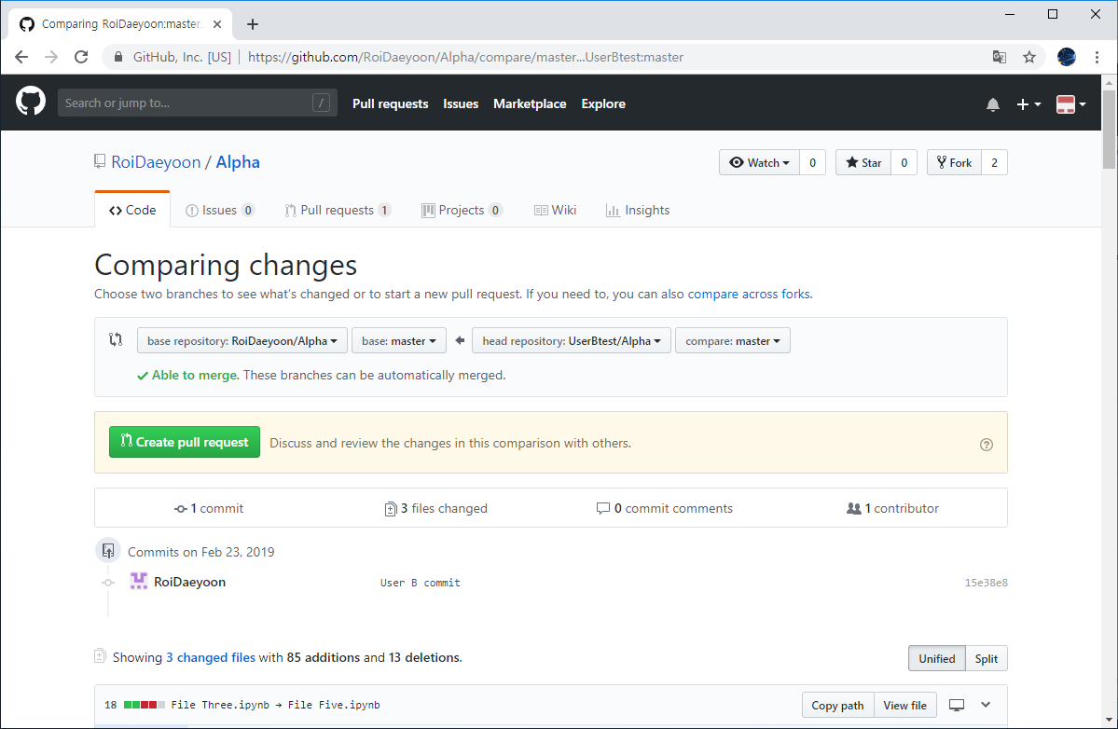

Slide 5
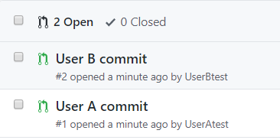

Slide 6
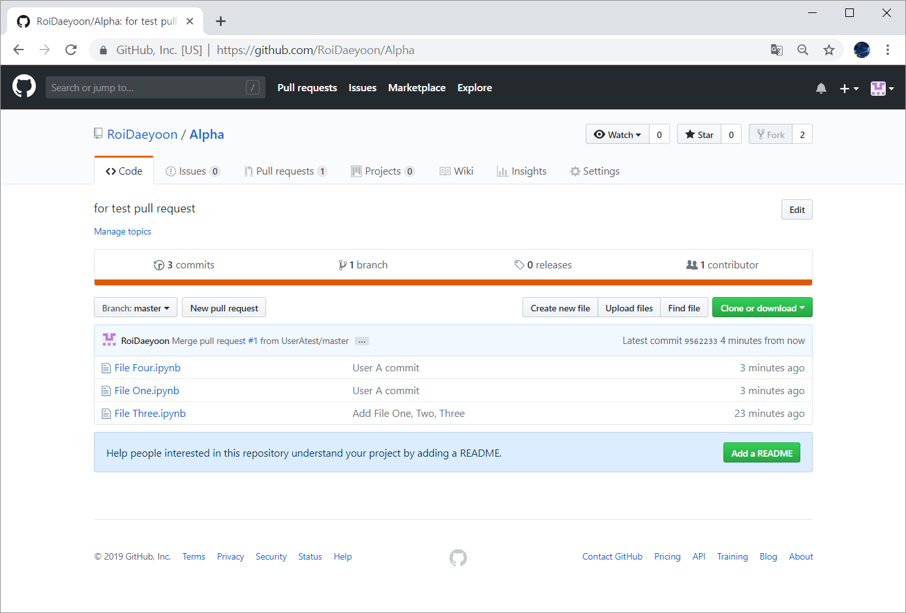

Slide 7
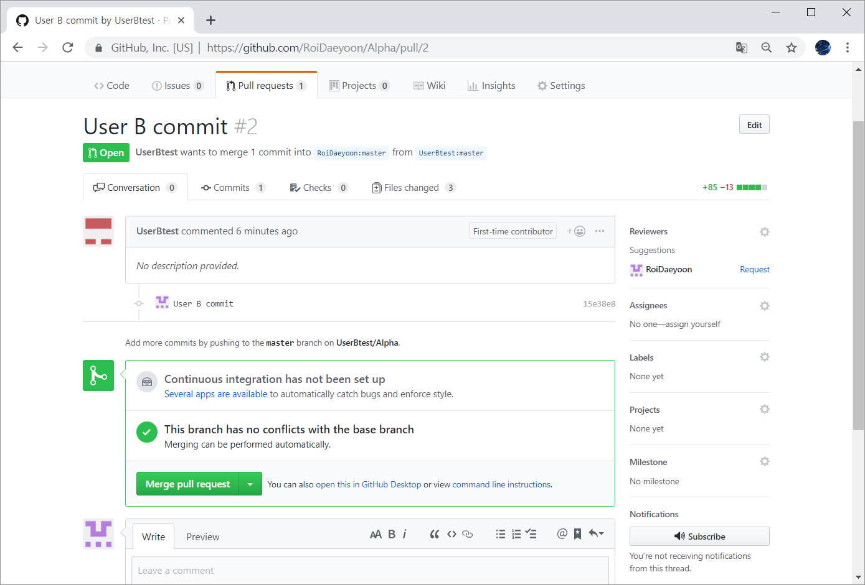

Slide 8
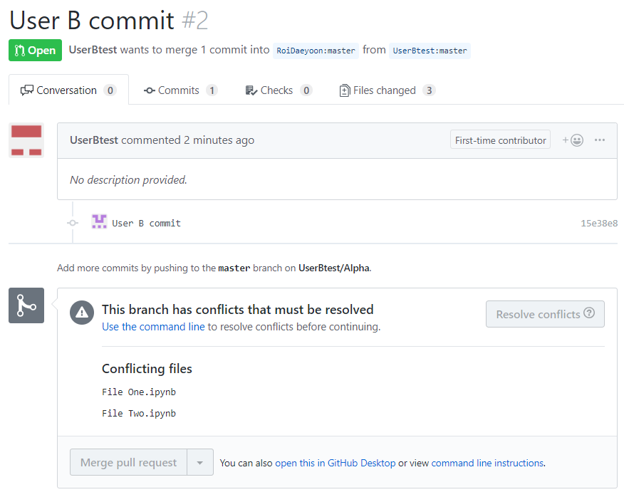

Slide 9
Project `Alpha`
File One / File Two / File Three
User A Commit
Chg. File One
Add. File Four
User B Commit
Chg. File One
Chg. File Two
Add. File Five

Slide 10
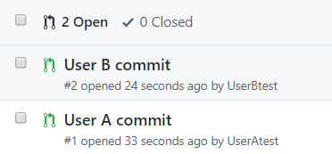

Slide 11
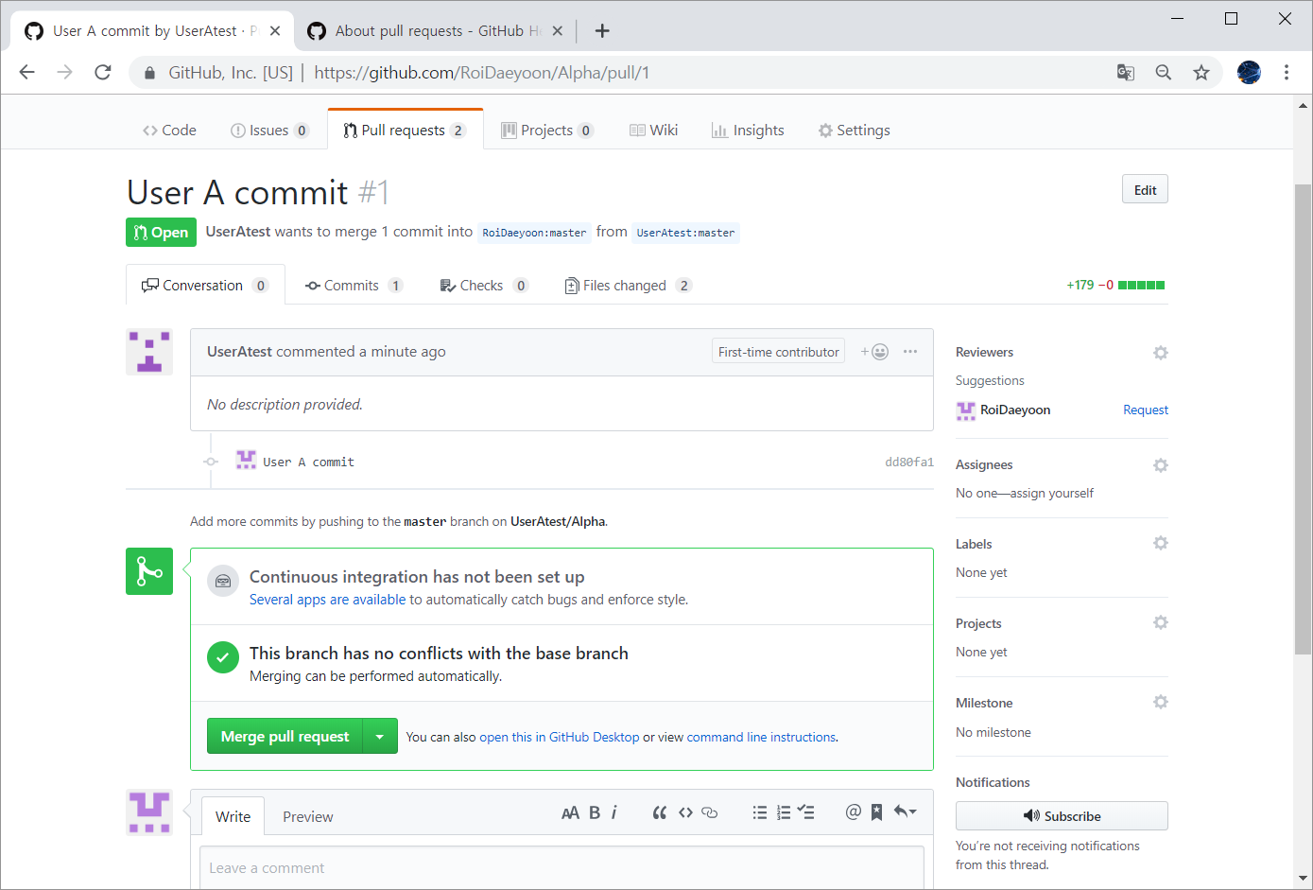

Slide 12
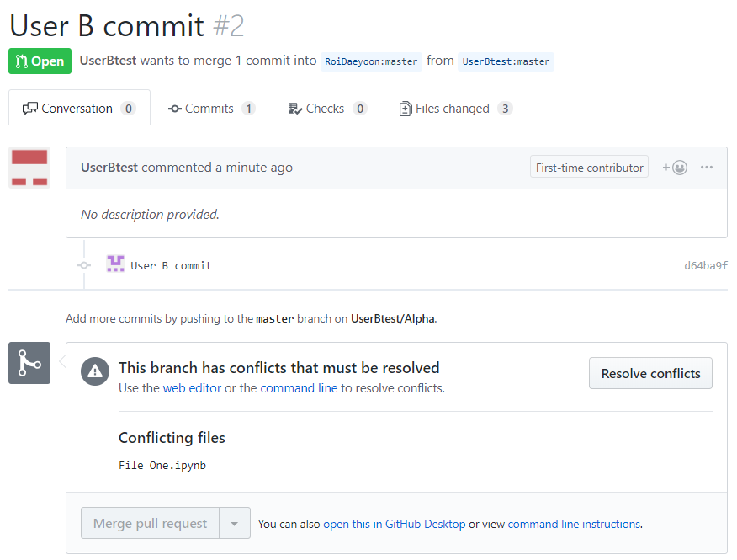

Slide 13
Project `Alpha`
File One / File Two / File Three
User A Commit
Add. File Four
User B Commit
Chg. File One

Slide 14
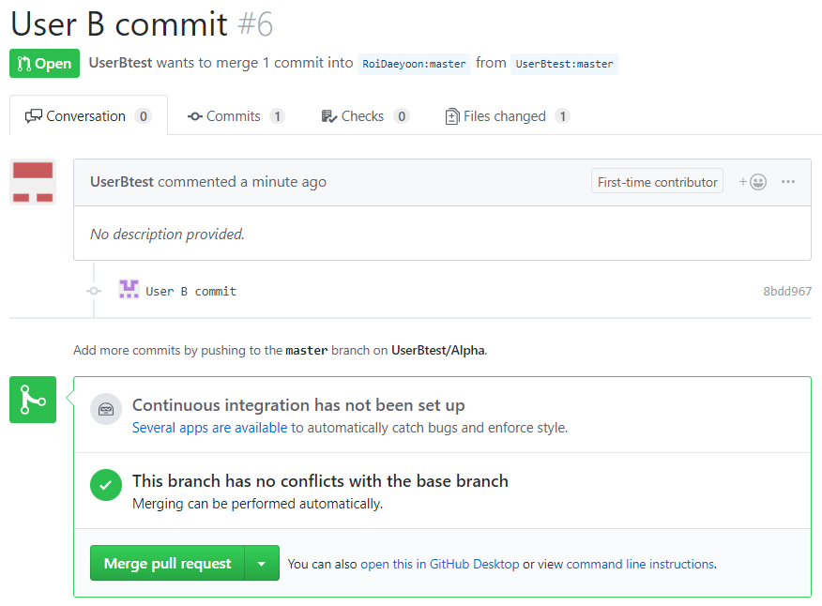

Slide 15
Project `Alpha`
File One
File Two
File Three
Project `Alpha`
File One’
File Three
File Four
User A Commit
Chg. File One
Del. File Two
Add. File Four

Slide 16
Project `Alpha`
File One
File Two
File Three
Project `Alpha`
File One
File Three
File Four
User A Commit
Chg. File One
Del. File Two
Add. File Four

Slide 17
Project `Alpha`
File One
File Two
File Three
Project `Alpha`
File One’
File Three
File Four
User A Commit
Chg. File One
Del. File Two
Add. File Four
User B Commit
Chg. File One
Chg. File Two
Del. File Three
Add. File Five

Slide 18
Project `Alpha`
File One
File Two
File Three
Project `Alpha`
File One’
File Two
File Three
File Four
User A Commit
Chg. File One
Add. File Four
User B Commit
Chg. File One
Chg. File Two
Add. File Five

Slide 19
Project `Alpha`
File One
File Two
File Three
Project `Alpha`
File One
File Two
File Three
File Four
Project `Alpha`
File One’
File Two
File Three
File Four
User A Commit
Add. File Four
User B Commit
Chg. File One

Slide 20
Project `Alpha`
File One
File Two
File Three
Project `Alpha`
File One’
File Three
File Four
User A Commit
Chg. File One
Del. File Two
Add. File Four

Slide 21
Project `Alpha`
File One
File Two
File Three
Project `Alpha`
File One
File Three
File Four
Project `Alpha`
File One’
File Three
File Four
User A Commit
Chg. File One

Slide 22
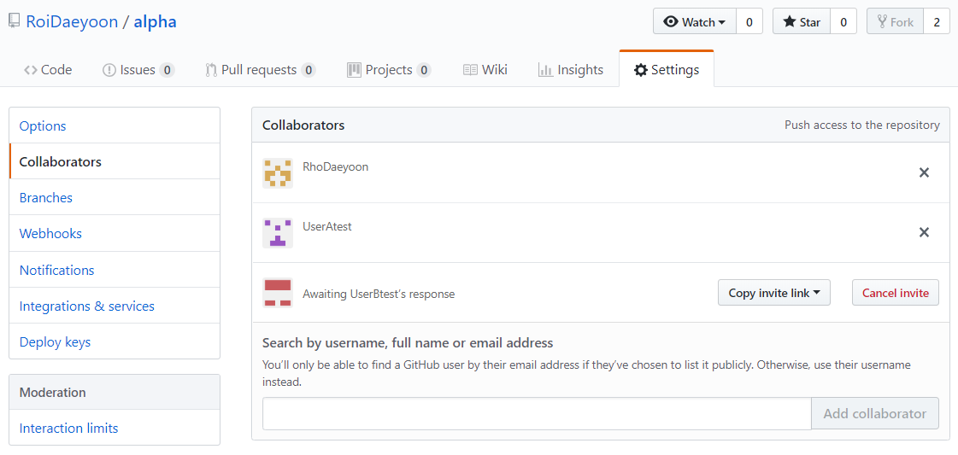
1
2
3

Slide 23
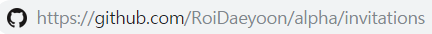
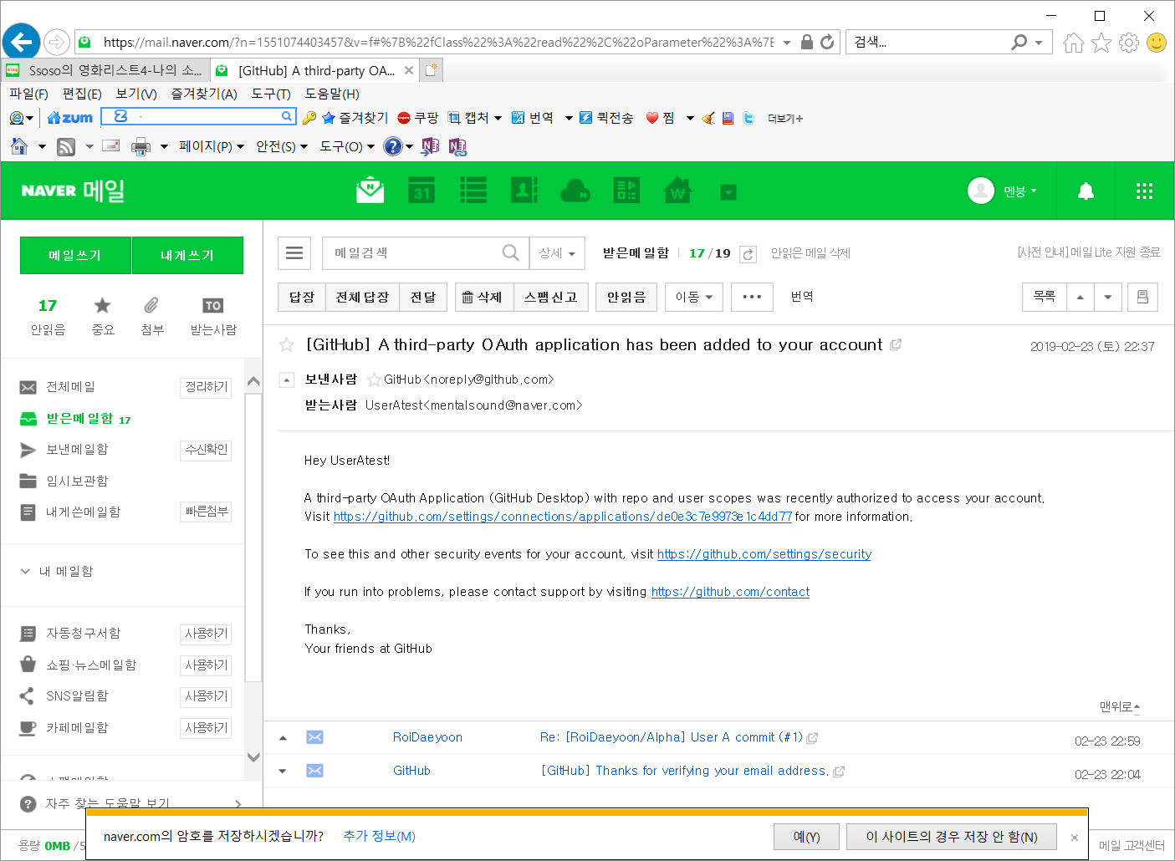

Slide 25
Project `Alpha`
File One / File Two / File Three
User A Commit
Chg. File One
Del. File Two
Add. File Four
User B Commit
Chg. File One
Chg. File Two
Del. File Three
Add. File Five

Slide 26
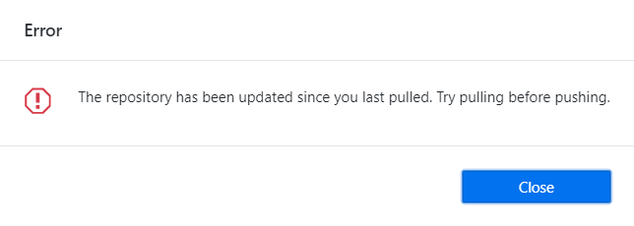

Slide 27
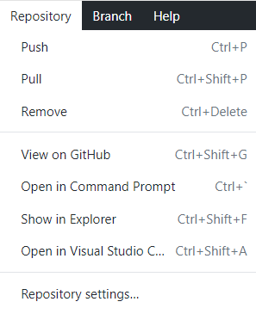

Slide 28
Project `Alpha`
File One / File Two / File Three
User A Commit
Chg. File One
User B Commit
Chg. File One

Slide 29
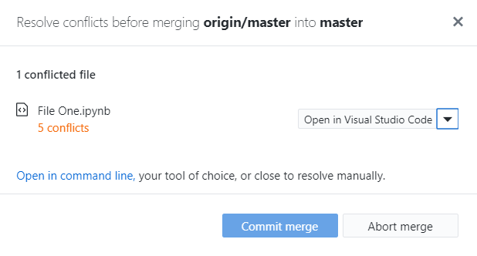

Slide 30
Project `Alpha`
File One
Project `Alpha`
File One’
Project `Alpha`
File One’’
Clone
1. Commit
2. Push
User A
Chg. File one
1. Pull
2. Commit
3. Push
User B
Chg. File One

